Slide 1


CASE FILE 001
AUDIO TRACE // LIVE VIEW
ON
DETECTIVE
ECHO
Listen closely. Follow the signal.
EchoDetective is a student C++ project concept focused on exploring sound-related clues, echoes, and patterns.
It uses a simple, investigation-style workflow to organize clues and present results.
The project demonstrates how programming logic can be used to build an interactive experience.
P R E S E N T E D B Y
HET PATEL
ID NO.:25EC412
if (clue_found) { investigate(); }
BIRLA VISHVAKARMA MAHAVIDYALAYA

Slide 2
Problem Statement
Why do we need a simple way to investigate sound clues?
SIGNAL ANALYSIS // VISUAL
The challenge: Sound can contain repeated patterns and useful clues, but beginners may find it difficult to represent, organize, and interpret these ideas in a simple program.
Our approach: Develop a beginner-friendly C++ project that applies structured logic to a clue-based investigation workflow.
Design priorities:
Simplicity — easy to understand.
Logic — clear decision-making.
Output — readable results.

Slide 3
TECHNOLOGY USED
Technology | Purpose
C++ | Core programming language
Visual Studio Code | Code editing and development
C++ Standard Library | Input/output and basic utilities
Console interface | User input and result displaay
Variables, data types, conditional statements, loops, functions, and input/output streams.

Slide 4
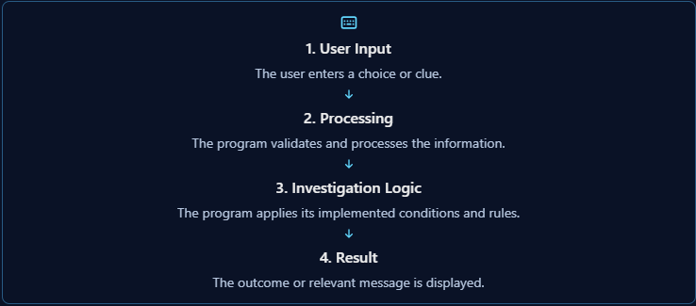
EchoDetective — Project Overview
What is EchoDetective?
Echo Detective is designed as an interactive investigation program in which the user provides information or clues, the program processes the input using predefined logic, and the results are displayed on the screen. The detective-style approach makes the project a practical demonstration of problem-solving and modular programming in C++.

Slide 5
Main Features of EchoDetective
1. Interactive User Interface
The program allows users to interact through a menu or input prompts. Users select an operation, provide the required information, and receive a response without needing to understand the internal code.
2. Clue or Information Processing
The program accepts the investigation data and processes it according to the logic implemented in C++. This is the stage where the input is prepared for further checks or analysis.
3. Rule-Based Analysis
Conditional statements and programmed rules determine which result or response should be produced. For example, the program may compare an input against a known condition and select the corresponding output.
4. Result Display and Feedback
After processing, the program displays the outcome or a useful message. Clear feedback helps the user understand what happened and whether another action is needed.
5. Modular Program Structure
Dividing the program into separate functions or modules makes it easier to read, test, debug, and extend. Each function can handle a specific responsibility rather than putting all the logic in one large block.

Slide 6
SYSTEM MODULES
EchoDetective — C++17 Echo Detection Simulator
01
Signal Generation
Generates a test signal by combining sine waves of different frequencies.
Function: {m.fn}
02
Echo Addition
Adds a delayed and quieter copy of the original signal.
Function: {m.fn}
03
Noise Generation
Adds random noise to simulate a less ideal signal.
Function: {m.fn}
04
Echo Detection
Compares delayed signal patterns and selects the delay with the highest normalized correlation score.
Function: {m.fn}
05
Result Reporting
Displays the estimated delay, correlation score, estimation error, and final status.
Function: {m.fn}
6

Slide 7
ECHO DELAY ESTIMATION
Illustrative code example
const int sampleRate = 8000;
const double delaySeconds = 0.25;
const int delaySamples =
static_cast<int>(
delaySeconds * sampleRate
);
cout << "Delay samples: "
<< delaySamples;
How it works
The sampling rate is 8,000 samples per second.
The simulated echo delay is 0.25 seconds.
The program converts the delay into samples.
0.25 × 8000 = 2000 samples
Detection process
Original Signal
→
Add Echo + Noise
→
Estimate Delay
7

Slide 8
Libraries and Their Functions
A header file provides declarations for standard functions, classes, and utilities used by the program.
1. <algorithm> — General Algorithms
Provides utilities such as max() and min(). In this project, they help restrict the minimum and maximum delay values searched by the echo-detection algorithm.
2. <cmath> — Mathematical Functions
Provides sin(), sqrt(), and mathematical operations. The project uses sine waves to generate the test signal and square roots to calculate the correlation denominator.
3. <iomanip> — Output Formatting
Provides formatting tools such as setprecision() and fixed, allowing numerical results to be displayed with four decimal places.
4. <iostream> — Input and Output
Provides cout to display the signal settings, estimated echo delay, correlation score, and final result in the console.
5. <random> — Random Number Generation
Provides mt19937 and normal_distribution. The project uses these to generate reproducible random noise for the simulated observed signal.
6. <string> — Text Handling
Provides the string type for text data. The current source includes this header, although it does not explicitly use a string variable.
7. <vector> — Dynamic Arrays
Provides vector, which stores the original signal and the observed signal as sequences of numerical samples. It allows the program to create and process signals containing thousands of samples.
8

Slide 9
Applications and Future Scope
Current project capabilities
Simulates a signal using a combination of sine waves at 440 Hz, 660 Hz, and 880 Hz.
Adds a delayed copy with a configurable echo gain.
Adds reproducible random noise.
Searches for the most likely echo delay using normalized correlation.
Reports the estimated delay, correlation score, and estimation error.
Potential applications
Learning digital signal processing concepts.
Demonstrating signal correlation and time-delay estimation.
Testing how noise affects echo detection.
Understanding signal-processing algorithms before implementing them in real-time systems.
Current limitations
Uses generated test signals rather than actual recorded audio.
Does not process microphone or MP3 input.
Its accuracy depends on the signal characteristics and selected search range.
Future enhancements
Add microphone or recorded-audio input.
Display original and observed waveforms.
Visualize the correlation score for different delays.
Test different noise levels and echo strengths.
Develop a graphical interface for easier experimentation.
Conclusion: EchoDetective demonstrates how a C++ program can simulate an echo, introduce noise, and estimate the delay using a correlation-based method.
9

Slide 10
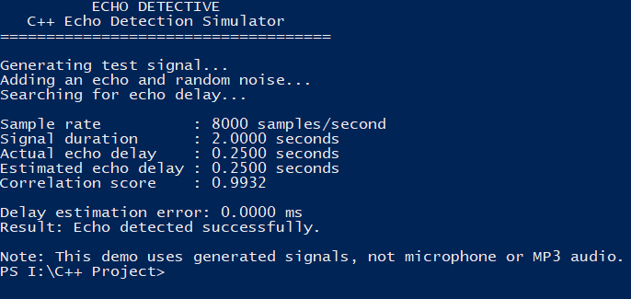
Output
10

Slide 11
References
Oppenheim, A. V., and Schafer, R. W. Discrete-Time Signal Processing, 3rd Edition, Prentice Hall, 2010. — Reference for discrete-time signals and signal-processing concepts.
E. Balagurusamy, Object Oriented Programming with C++, McGraw Hill Education.
Here is the official publisher page: McGraw Hill Education — Object Oriented Programming with C++. Use the edition that matches the book you have; you don't need to mention an edition or publication year if you're unsure.
3. cppreference.com — C++ Standard Library. Documentation for std::vector, mathematical functions, random-number generation, and input/output.
11

Slide 12
THANK YOU
ECHO DETECTIVE | C++ ECHO DETECTION SIMULATOR
QUESTIONS?

